Slide 1
Photomicrographs of Plant foods
Pineapple
Permission to reproduce original photomicrographs used to make this collection may be obtained from
Dr. David O. Norris at
david.norris@colorado.edu

Slide 2
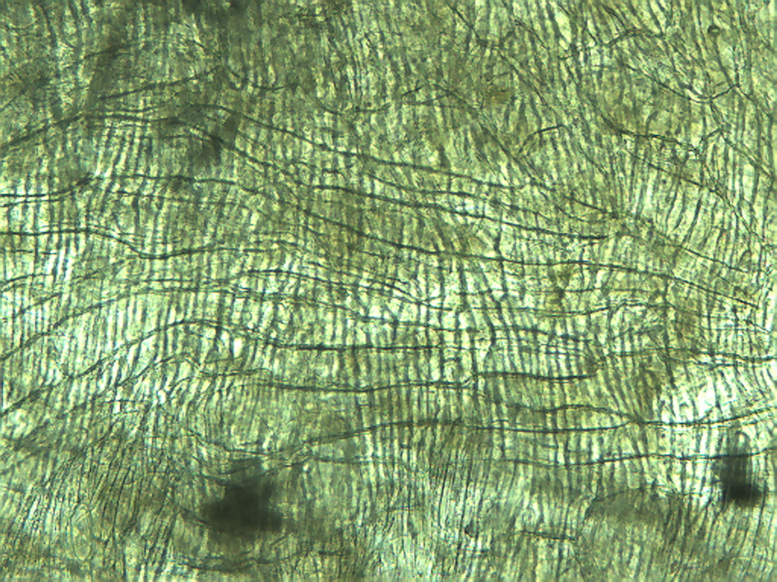
Notes:
388. Ananas comosis (L.) Merr. Pineapple. Large elongate cells running across with small elongate cells at right angles to the large cells, 10X.

Slide 3
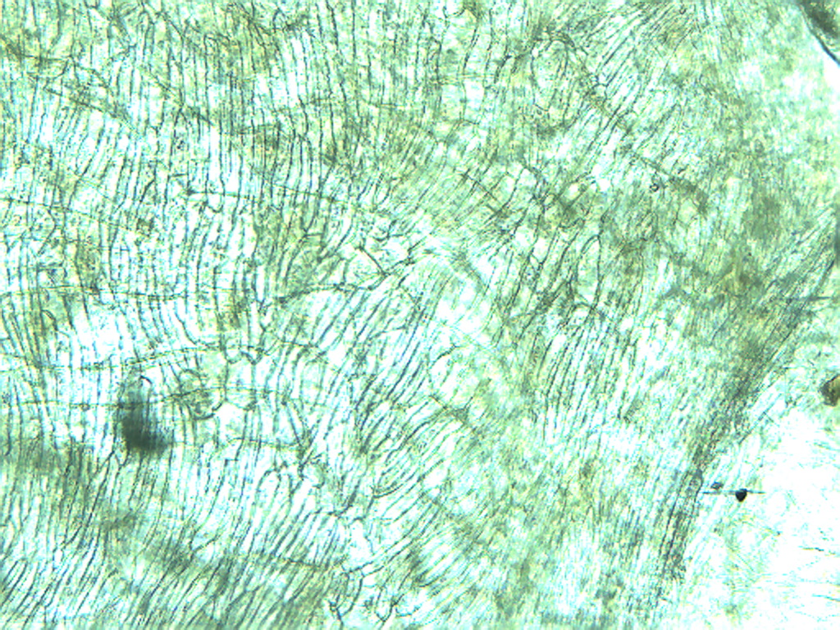
Notes:
389. Pineapple. Smaller elongate cells, 10X

Slide 4
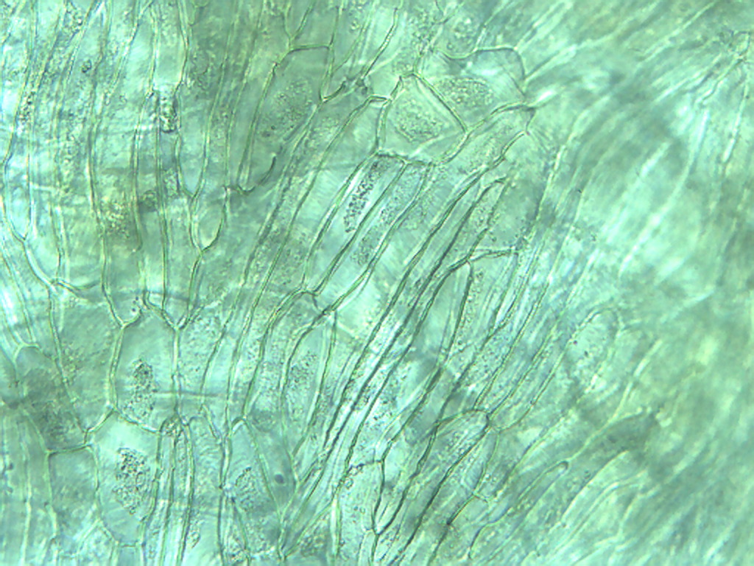
Notes:
390. Pineapple. Smaller elongate cells plus some more cuboidal cells (arrows) mixed in, 25X.

Slide 5
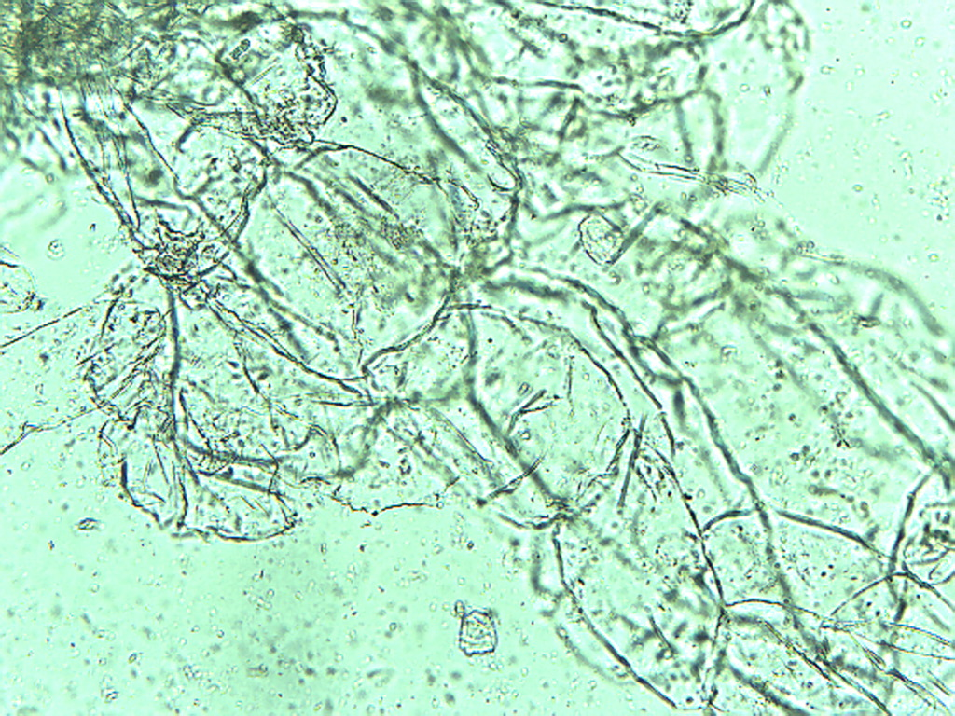
Notes:
391. Pineapple. Large parenchymal cells in pulp, 10X.

Slide 6
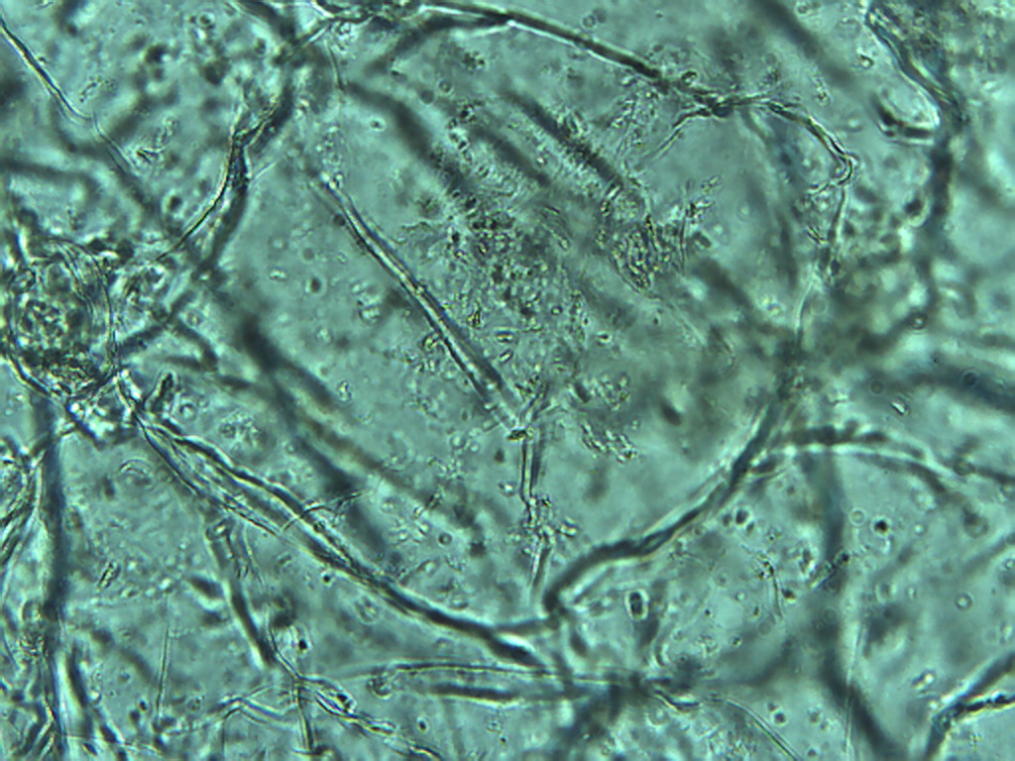
Notes:
392. Pineapple. Large parenchymal cell in pulp, 25X.

Slide 7
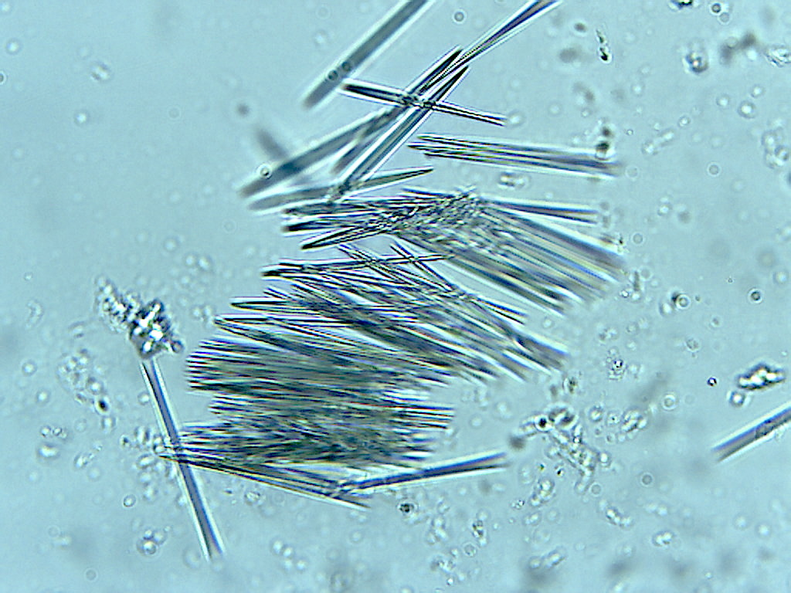
Notes:
393. Pineapple. Raphides, 25X. Compare with asparagus and kiwi raphides, 40X.

Slide 8
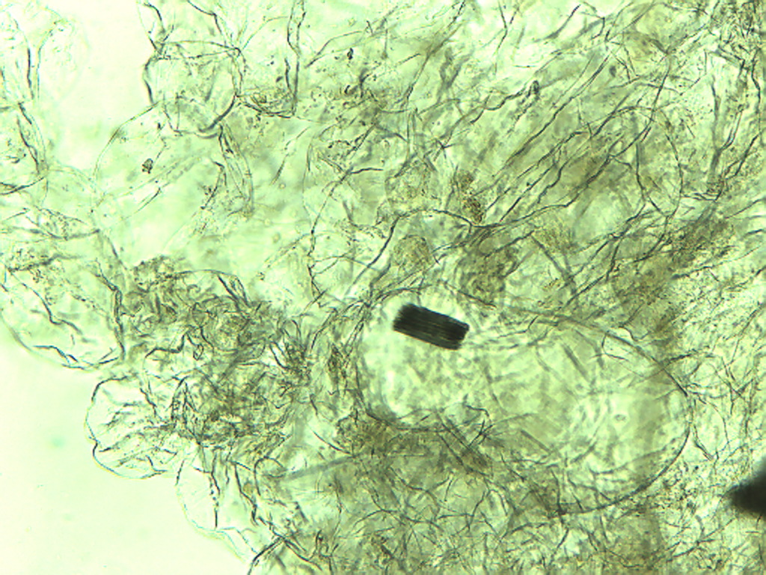
Notes:
394. Pineapple. Bundle of raphides in large parenchymal cell, 10X.

Slide 9
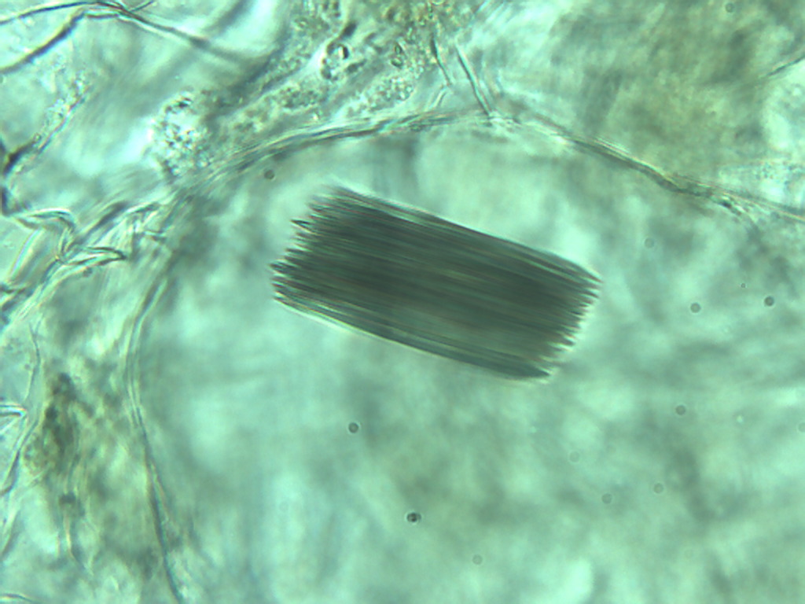
Notes:
395. Pineapple. Raphide bundle in large parenchymal cell, 40X.

